Slide 1
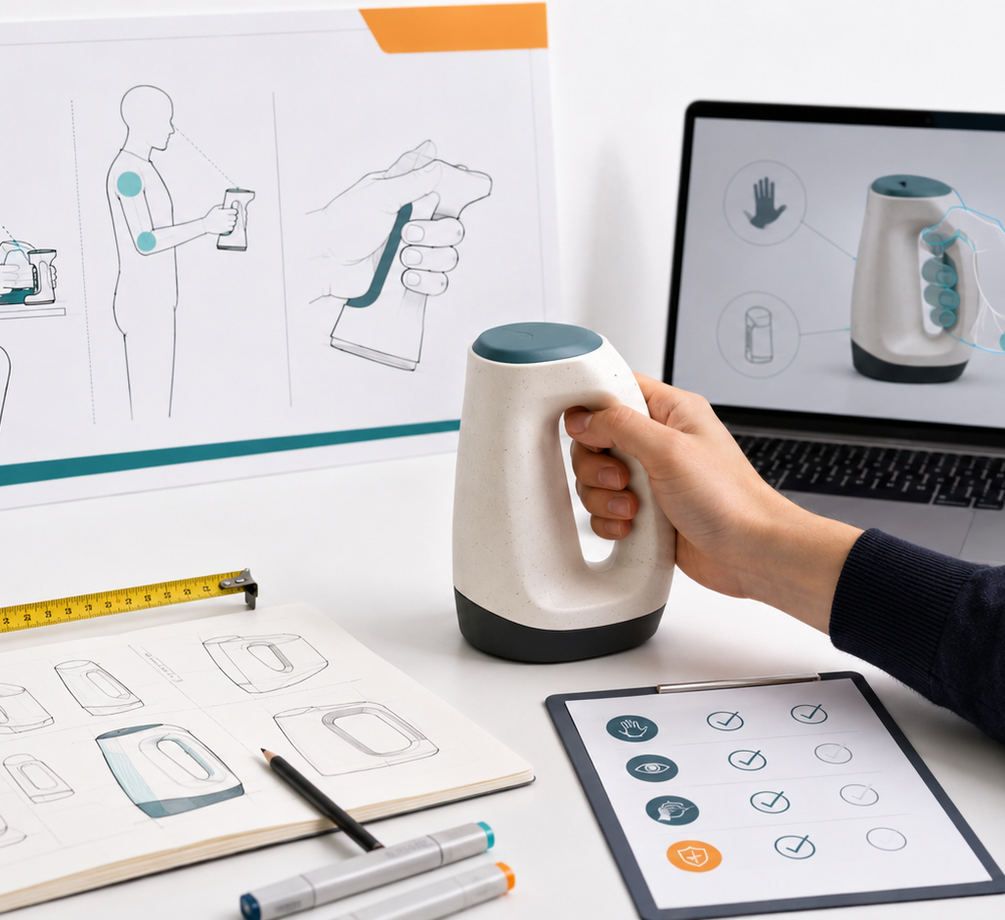
SESSION 5
Ergonomics,
Use Diagrams
and Validation Plan
Turning product specifications into user interaction, safety criteria and test evidence.
Technical report fragment
Evidence-ready
Specification of Products and Services

Slide 2
SESSION 5
Why this session matters
From “it should work” to “we can prove it works.”
Before
Today
After
Concept
Requirements
Materials
Parts list
Use sequence
Ergonomics
Risks
Validation plan
Final tests
Evidence
Production report
Reports already have concept, requirements, materials, parts and BOM direction. Must explain how the product is used, where it touches the user or context, what could fail, and what evidence will prove performance.
Key idea
The report must not only describe the product. It must explain how the user interacts with it and how the team will test comfort, safety, stability, ease of use and performance.
Specification of Products and Services

Slide 3
DELIVERABLE
Session 5 report structure
01 User-product interaction
02 Use sequence
03 Ergonomic analysis
How the user touches, wears, carries, opens, closes, adjusts or transforms the product.
Visual step-by-step explanation of the product in use.
Posture, grip, load, pressure, fit, movement and comfort.
04 Contact points + risks
05 Validation plan
06 Next steps
Where the product touches the body, object, vehicle or environment, and what could fail.
Tests, success criteria and evidence needed.
What must be measured, tested, redrawn or corrected before Session 6.
Specification of Products and Services

Slide 4
SESSION 5
Use sequence: show the product in action
A use sequence makes the product understandable.
Must show the main interaction as a clear sequence. It can be sketches, photos, renders or simple diagrams.
1
Prepare
2
Adjust / attach
3
Use
What does the user do before using it?
How is it placed, connected or fitted?
What is the main action or benefit?
4
Access / transform
5
Store / carry
6
Maintain
How does the user open, remove, fold or activate it?
What happens after use?
How is it cleaned, charged, replaced or stored?
Specification of Products and Services

Slide 5
SESSION 5
Ergonomic analysis: what to observe
Body fit
Grip + access
Load + weight
Pressure
Size, adjustment, body area, posture and movement range.
How the hand reaches, holds, pulls, opens or detaches the product.
Where the weight goes and whether it causes fatigue or imbalance.
Contact zones, discomfort, rubbing, sharp edges or tight areas.
What to include in the report
Area
Question
Output
Evidence
Posture
Does it force awkward movement?
Posture notes
Photo / diagram
Fit
Can different users adjust it?
Fit range
Test notes
Movement
Does it interfere with activity?
Movement check
Video
Comfort
Can it be used for a defined time?
Rating / comments
Survey
Specification of Products and Services

Slide 6
SESSION 5
Critical contact points and safety risks
Mark the zones where the product touches or could fail.
This section should become useful evidence for both the technical report and the visual explanation of comfort, safety and trust.
Contact point
Possible risk
What to check
Evidence
Body
Pressure / discomfort
Fit, rubbing, posture
Annotated photos
Object / gear
Detachment / slipping
Grip, load, retention
Video test
Vehicle / board
Vibration / instability
Movement, balance, contact
Movement test
Mechanism
Pinch / breakage
Edges, force, repeated use
Risk checklist
Liquid / weather
Leak / damage
Water, sweat, cleaning
Basic test notes
Specification of Products and Services

Slide 7
SESSION 5
Evidence needed: make it documentable
Photos
Videos
Measurements
Use, contact points, scale, body fit, prototype detail.
Movement, access time, transformation, stability, load behavior.
Time, dimensions, weight, load, distance, temperature, force.
Surveys
Diagrams
Tables
Comfort rating, difficulty, trust, understanding, purchase interest.
Use sequence, risk map, ergonomic map, test setup.
Test criteria, results, missing data and improvement plan.
Specification of Products and Services

Slide 8
REPORT CHECKLIST
What to submit for Session 5
Cover / header with project name, team and main image
User-product interaction: what the user does with the product
Use sequence: visual step-by-step process
Ergonomic analysis: posture, grip, weight, pressure, fit or movement
Critical contact points and safety risks
Validation plan with tests, success criteria and evidence
Technical explanation for the final production report
Visual/commercial explanation for the user-facing report
Missing information and next steps
Suggested length: 8–12 pages. Use images, diagrams, tables, captions and short paragraphs.
Specification of Products and Services

